Slide 1
Enterprise Messaging systems
With Kafka

Slide 2
What is EMS?
Enterprise Messaging Systems EMS in short is a system that enables data transfer across disparate sytems.
In EMS terminology the word messaging is used to describe asynchronous messages that consists of requests, reports or events that are consumed by enterprise applications and not humans
These messages contain information that is needed to coordinate systems and track progress of the enterprise.
Enterprise messaging systems, which are language and platform-independent solutions, are also called messaging services, or more formally, messaging-oriented middleware (MOM).
Promotes Loosely Coupled Systems.

Slide 3


What is Synchronous Messaging ?
Synchronous messaging describes communication that takes place between two applications or systems, where the system places a message in a message queue (also called an Event Queue in enterprise messaging systems) and then waits for a message response before it continues processing.
Something that is happening in real time. Synchronous communication examples include: instant messaging, video conferencing, webcams,
Telephonic conversations.

Slide 4

What is ASynchronous Messaging ?
Asynchronous messaging describes communication that takes place between two applications or systems, where the system places a message in a message queue (called an Event Queue in enterprise messaging systems) and does not wait for a reply to continue processing.
Asynchronous groupware includes e-mail, version control systems, or collaborative writing systems.
SMS messaging

Slide 5
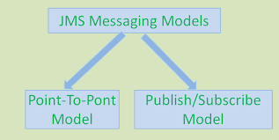
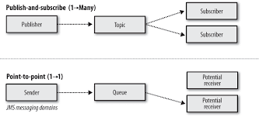

JMS- Java Messaging System
It is a messaging standard that allows application components based on Java EE to create, send, receive, and read messages. It allows the communication between different components of a distributed application to be loosely coupled, reliable, and asynchronous
publisher sends messages into 1 or more topics
subscribers can arrange to receive 1 or more topics, then consume all the messages
producer sends messages into the queue, each message is read by only one consumer
once the message is consumed, it vanishes
multiple consumers can read messages from the queue

Slide 6
Apache ActiveMQ is an open source message broker written in Java together with a full Java Message Service (JMS) client. It provides "Enterprise Features" which in this case means fostering the communication from more than one client or server. Supported clients include Java via JMS 1.1 as well as several other "cross language" clients
ZooKeeper is a centralized service for maintaining configuration information, naming, providing distributed synchronization, and providing group services. All of these kinds of services are used in some form or another by distributed applications. Each time they are implemented there is a lot of work that goes into fixing the bugs and race conditions that are inevitable. Because of the difficulty of implementing these kinds of services, applications initially usually skimp on them, which make them brittle in the presence of change and difficult to manage. Even when done correctly, different implementations of these services lead to management complexity when the applications are deployed.

Slide 8
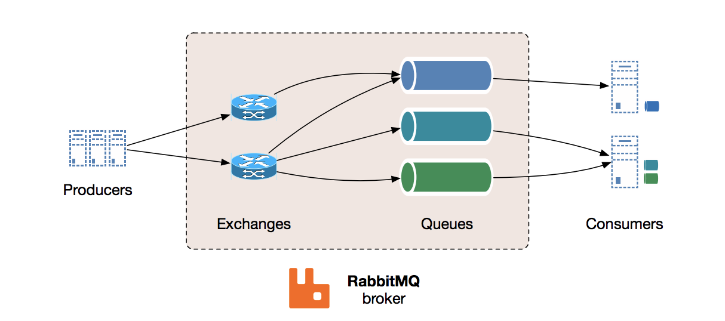

MESSAGE BROKER
A message broker is an architectural pattern for message validation, transformation, and routing. It mediates communication among applications, minimizing the mutual awareness that applications should have of each other in order to be able to exchange messages, effectively implementing decoupling
RabbitMQ is a “traditional” message broker that implements variety of messaging protocols. It was one of the first open source message brokers to achieve a reasonable level of features, client libraries, dev tools, and quality documentation. RabbitMQ was originally developed to implement AMQP, an open wire protocol for messaging with powerful routing features.
Apache Kafka is developed in Scala and started out at LinkedIn as a way to connect different internal systems. At the time, LinkedIn was moving to a more distributed architecture and needed to reimagine capabilities like data integration and realtime stream processing, breaking away from previously monolithic approaches to these problems. Kafka is well adopted today within the Apache Software Foundation ecosystem of products and is particularly useful in event-driven architecture.

Slide 9
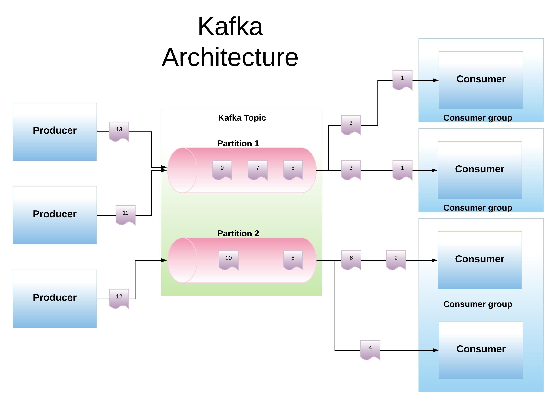

Slide 10
Kafka Features
1. Scalability Apache Kafka can handle scalability in all the four dimensions, i.e., event producers, event processors, event consumers and event connectors. In other words, Kafka scales easily without downtime. 2. High-Volume Apache Kafka can work with a huge volume of data streams, easily. 3. Data Transformations Apache Kafka offers provisions for deriving new data streams using the data streams from producers.
4. Fault Tolerance Apache Kafka clusters can handle failures with the masters and databases.
5. Reliability Since Apache Kafka is distributed, partitioned, replicated, and fault tolerant, it is very reliable.
6. Durability Apache Kafka is durable because it uses Distributed commit logs, which means messages persist on disk as fast as possible.

Slide 11
7. Performance For both publishing and subscribing messages, Kafka has high throughput. Even if many TBs of messages are stored, it maintains stable performance. 8. Zero Downtime Apache Kafka is very fast and guarantees zero downtime and zero data loss.

Slide 12
Kafka Terminology
1. Kafka Broker There are one or more servers available in Apache Kafka cluster, basically, these servers (each) are what we call a broker. A Kafka server, a Kafka broker and a Kafka node all refer to the same concept and are synonyms.
3. Kafka Partitions Kafka topics are divided into a number of partitions, which contains messages in an unchangeable sequence. Each message in a partition is assigned and identified by its unique offset. A topic can also have multiple partition logs like the click-topic has in the image to the right. This allows for multiple consumers to read from a topic in parallel.
2. Kafka Topics A topic is a category of messages in Kafka. The producers publish the messages into topics and the consumers read the messages from topics. Data is stored in topics. A topic is divided into one or more partitions. In addition, all Kafka messages are generally organized into Kafka topics.

Slide 13
4. Kafka Producers Producers are the publisher of messages to one or more Kafka topics. Producers send data to Kafka brokers. Every time a producer publishes a message to a broker, the broker simply appends the message to the last segment file. Actually, the message will be appended to a partition. Producer can also send messages to a partition of their choice.
6. Kafka offset The offset is a unique identifier of a record within a partition. It denotes the position of the consumer in the partition.
5. Kafka Consumers Consumers read data from brokers. Consumers subscribes to one or more topics and consume published messages by pulling data from the brokers.

Slide 14
Kafka Message Ordering and Client Acknowledgments In Kafka, the order of the messages delivered from a certain partition and messages received by the partition is same.
Kafka Cluster A group of computers which are acting together in order to achieve a common purpose is what we call a cluster. In Kafka also, it has the same meaning i.e. a group of computers, each having one instance of Kafka broker.
In the Apache Kafka cluster, a node is a single computer.
Kafka Message In one line, Message in Kafka is an information which travels from the producer to a consumer through Apache Kafka.
Kafka Replicas Here, the word replica refers to a backup. That means a replica of a partition is a “backup” of a partition. Basically, we use replicas in order to prevent data loss, they never read or write data.
Kafka Leader A node which is responsible for all reads and writes for the given partition is what we call a Kafka Leader. So, every partition consists of one server, which acts as a leader.

Slide 15
Follower in Kafka Simply putting, a node that follows leader instructions is what we call a follower. The basic usage of a follower is, if any leader fails, any of these followers will automatically become the new leader. However, it plays as the normal consumer, which pulls messages and also updates its own data store.
Kafka Connector API The API which permits to build as well as run reusable consumers or producers that connects existing applications or data systems to Kafka topics, we use the Connector API.
Kafka Data Log Messages are preserved through Kafka, especially for a considerable amount of time. That means consumers can read as per their convenience. Since Kafka is configured to keep messages for 24 hours but somehow consumer is down for time greater than 24 hours, in that case, the consumer will lose messages. Still, it is possible to read that message from last known offset, only if the downtime on part of the consumer is just 60 minutes.

Slide 16
Real time Use cases of Kafka
https://www.confluent.io/blog/publishing-apache-kafka-new-york-times/
https://kafka.apache.org/documentation/streams/
https://www.confluent.io/blog/real-time-financial-alerts-rabobank-apache-kafkas-streams-api/

Slide 17
1. Start Zookeeper. (zookeeper is built in Kafka- so no need to install again)
be inside kafka directory.
bin\windows\zookeeper-server-start config\zookeeper.properties.
(starts in localhost port 2181)
2. Start Kafka Server
start kafka server
bin\windows\kafka-server-start config\server.properties
#Producer
bin\windows\kafka-console-producer --broker-list localhost:9092 --topic test
#consumer
bin\windows\kafka-console-consumer.bat --bootstrap-server localhost:9092 --topic testingtopic --from-beginning
#delete topic
kafka-run-class.bat kafka.admin.TopicCommand --delete --topic test --zookeeper localhost:2181
# Listing topics
bin\windows\kafka-topics.bat --list --zookeeper localhost:2181
//creating a topic
kafka-topics --create --bootstrap-server localhost:9092 --replication-factor 1 --partitions 1 --topic testingtopic

Slide 18
Creating a Kafka Producer in Spring Boot
1. Create a SpringBootStarter Project with following dependencies.
a web
b dev tools
c kafka
2. Create a RestController class Eg.Producer
@RestController
public class Producer {
private static final String TOPIC = "Kafka_Topic";
@Autowired
KafkaTemplate<String, Item> kafkaTemplate;
@GetMapping("/post/{message}")
public String post(@PathVariable("message") String message)
{
kafkaTemplate.send(TOPIC, message);
return "Message Sent Successfully";
}
}
Message is published to a topic called Kafka_Topic
Notes:
https://codenotfound.com/spring-kafka-consumer-producer-example.html
https://cloud.spring.io/spring-cloud-static/spring-cloud-stream-binder-kafka/2.1.0.RC1/multi/multi__partitioning_with_the_kafka_binder.html
https://www.allprogrammingtutorials.com/tutorials/changing-replication-factor-of-topic-in-kafka.php

Slide 19
Creating a Kafka Producer in Spring Boot that send an Object in Json format
@Configuration
public class ProducerConfiguration {
private ProducerFactory<String, Item> producerFactory;
public ProducerFactory<String, Item> getProducerFactory(){
Map<String,Object> configs=new HashMap<>();
configs.put(ProducerConfig.BOOTSTRAP_SERVERS_CONFIG,"localhost:9092");
configs.put(ProducerConfig.KEY_SERIALIZER_CLASS_CONFIG, StringSerializer.class);
configs.put(ProducerConfig.VALUE_SERIALIZER_CLASS_CONFIG, JsonSerializer.class);
return new DefaultKafkaProducerFactory<>(configs);
}
@Bean
public KafkaTemplate<String,Item> getKafkaTemplate()
{
return new KafkaTemplate<>(getProducerFactory());
}
}

Slide 20
SpringBoot with inmemory activemq
Steps
1 Add dependencies
- web and activemq
2 in application.resources
spring.activemq.in-memory=true
spring.activemq.pool.enabled=false
server.port=8081
3 Create a Configuration Class
@EnableJms
@Configuration
public class MessageConfiguration {
@Bean
public Queue queue() {
return new ActiveMQQueue("myqueue");
}
}

Slide 21
//Producer
@RestController
public class Producer {
@Autowired
private JmsTemplate jmsTemplate;
@Autowired
private Queue queue;
@GetMapping("/publish/{message}")
public String publishMessage(@PathVariable("message") String message)
{
jmsTemplate.convertAndSend(queue, message);
return "Message published Sucessfully";
}
}
@Component
public class Consumer {
@JmsListener(destination = "myqueue")
public void listener(String message) {
System.out.println("Received Message: " + message);
}
}

Slide 22
SpringBoot with standalone activemq
Steps
1 Add dependencies
- web and activemq
2 in application.resources
spring.activemq.in-memory=false
spring.activemq.pool.enabled=false
server.port=8081
activemq.broker-url=tcp://localhost:61616
Installation and apache activemq
https://activemq.apache.org/components/classic/download/
To start activemq : activemq start
Admin console: http://localhost:8161/

Slide 23
//Create a Configuration Class
@EnableJms
@Configuration
public class MessageConfiguration {
@Value("${activemq.broker-url}")
private String brokerUrl;
@Bean
public Queue queue() {
return new ActiveMQQueue("queue3");
}
@Bean
public ActiveMQConnectionFactory activeMQConnectionFactory() {
ActiveMQConnectionFactory factory = new ActiveMQConnectionFactory();
factory.setBrokerURL(brokerUrl);
return factory;
}
@Bean
public JmsTemplate jmsTemplate() {
return new JmsTemplate(activeMQConnectionFactory());
}}
Notes:
https://activemq.apache.org/components/classic/download/
To start activemq : activemq start
Admin console: http://localhost:8161/

